Slide 1
Shell Bootcamp 2024 3 Reflections for Week 2
Mantra Jain
Date : 30-Aug-2024

Slide 2

About Me
Please share a phrase that represents
your motto in life
“Dream Big,
Work Hard,
Stay Humble”

Slide 3

My learnings from this week!

Slide 4
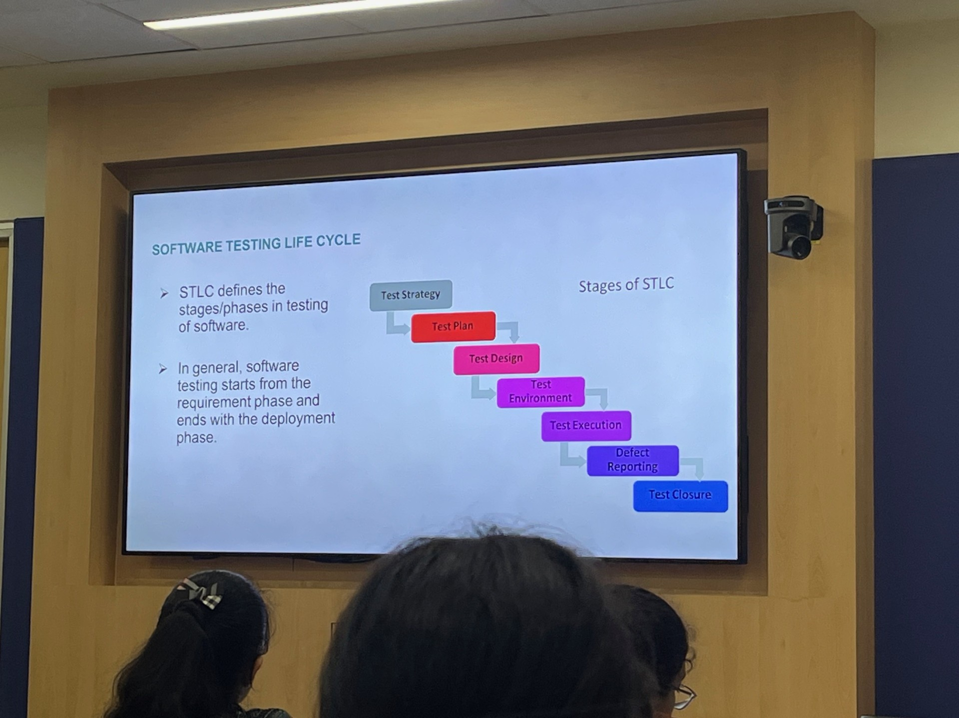
Learning 1 | My takeaways
Details of the learning:
STLC
V-Lifecycle Model: It refers to the ability to recognize, understand, manage, and utilize emotions effectively in oneself and in interactions with others.
Agile Testing: Techniques for truly understanding and responding to the emotions and perspectives of others.
Fitnesse Tool: Test driven development helps in reducing bugs and improving quality of code.

Slide 5
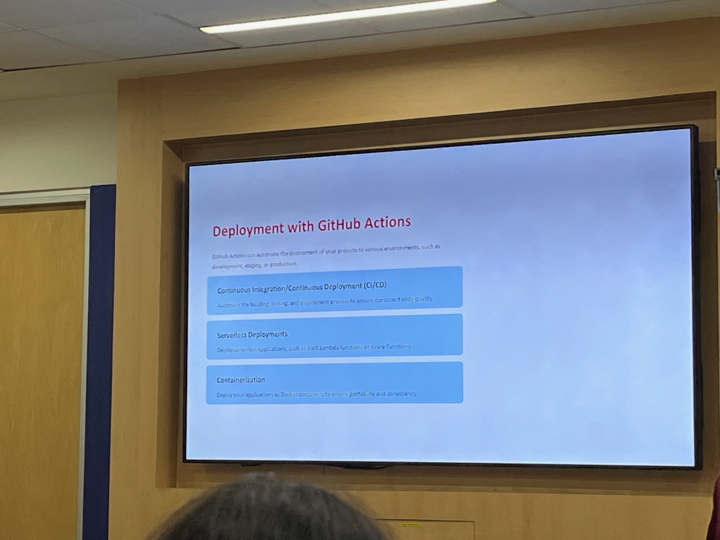
Learning 2 | My takeaways
Github Actions
Workflow->Event->Job->Action->Runner
Two new Types of DBMS:
OLTP (Online Transactional Processing )
OLAP Database (Online Analytical Processing )
Cloud Service Model:
SAAS- Software CRM
IAAS- AWS, Azure

Slide 6
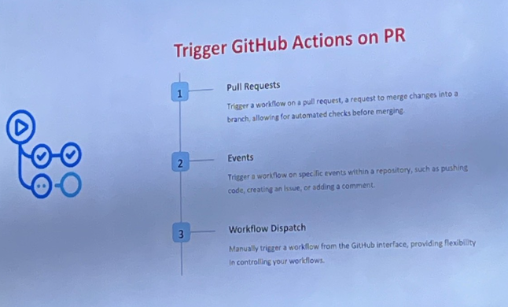
Learning 3 | My takeaways
Principle of DevOps
Automation
Iteration
Continuous Improvement
Collaboration
Benefits of Devops
High ROI
Improved Collaboration
Early Detection and Correction of Issues

Slide 7

Relevance of learnings for my organization

Slide 8
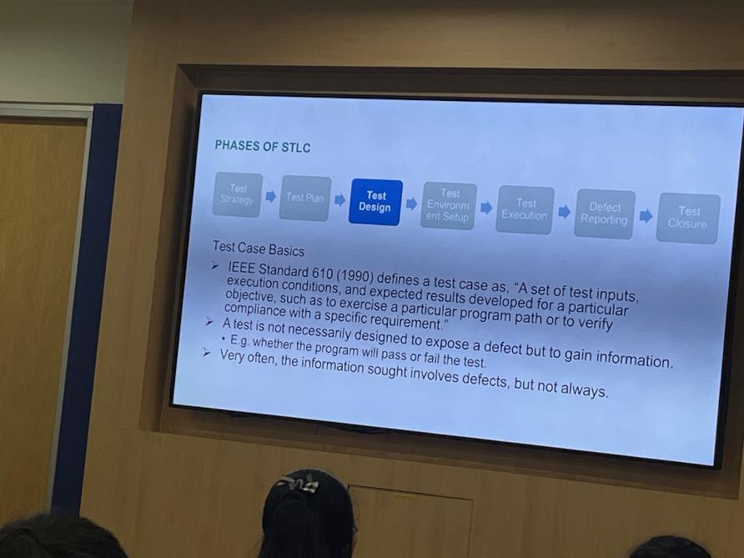
Learning 1 | Relevance for Shell
Test-Driven Development (TDD) helps by:
Reducing Bugs: Catches issues early in the development process, leading to fewer bugs and errors.
Improving Code Quality: Promotes clean, modular, and well-structured code.
Enhancing Software Stability: Ensures higher stability and reliability of the software.
Better Design Decisions: Encourages developers to write code that is easy to test, maintain, and scale

Slide 9
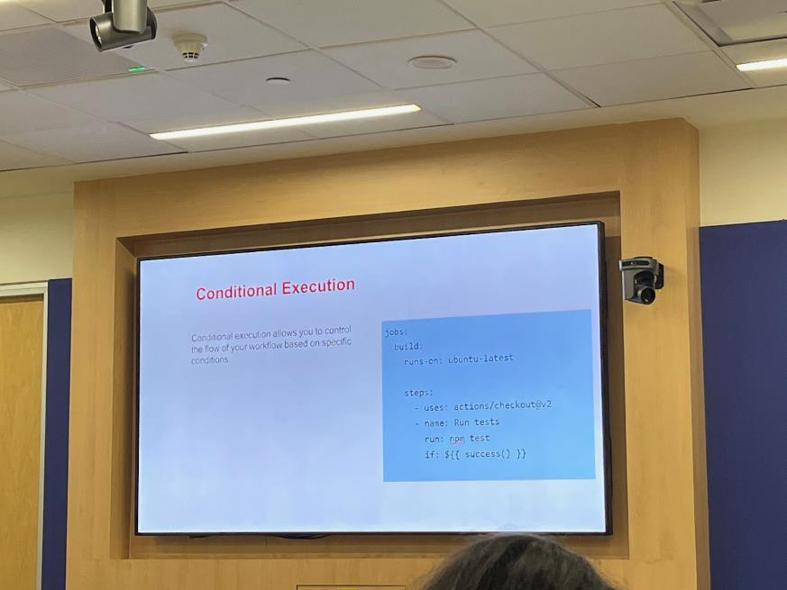
Learning 2 | Relevance for Shell
How I feel Shell implements this learning ?
Customizing Workflows: Tailors automation to specific project needs, enhancing flexibility1.
Ensuring Compliance: Helps enforce security and governance policies across the development process
How I feel Shell benefits from this learning ?
Global Reach: Access to a network of centres ensures high availability and performance.
Integrated Services: Seamless integration with other Microsoft tools and services enhances productivity.

Slide 10
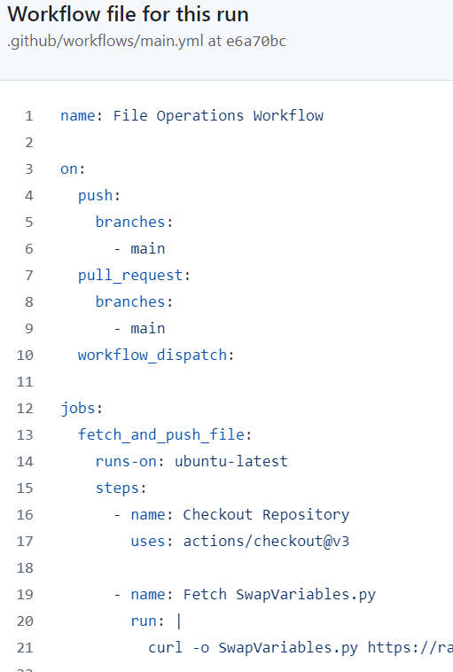
Learning 3 | Relevance for Shell
How I feel Shell implements this learning?
CI/CD: Automates testing, speeds releases, provides feedback, improves collaboration, reduces errors, enhances quality.
Enhancing Collaboration: It unites developers, project managers, and other stakeholders, fostering better teamwork.
How I feel Shell benefits from this learning?
Automating Workflows: CI/CD pipelines streamline the build, test, and deployment processes, reducing manual effort.

Slide 11

Challenges in implementing learning

Slide 12
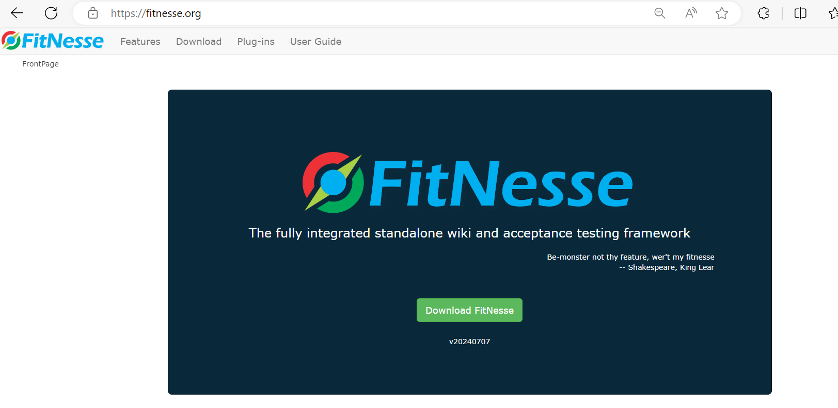
Challenge faced while implementing Learning 1
Learning Curve: FitNesse has a unique syntax and structure, which was difficult to learn and master.
Integration Issues: Integrating FitNesse with existing systems and workflows was complex and time-consuming.
Maintenance Overhead: Keeping the test suites up-to-date with changing requirements and codebases required continuous effort.
Performance Concerns: Running large test suites can be slow, impacting the overall development cycle.

Slide 13
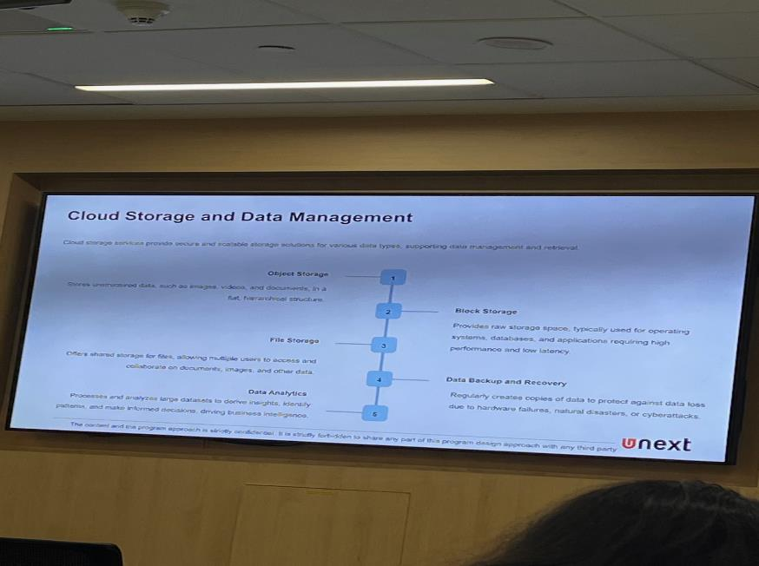
Challenge faced while implementing Learning 2
Managing Secrets and Environment Variables: Ensuring sensitive data is securely handled can be complex.
Integration Complexity: Integrating GitHub Actions with existing workflows and tools may require significant effort.
Debugging Workflows: Troubleshooting failed workflows can be time-consuming and complex.
Resource Limits: Hitting GitHub’s usage limits for actions, storage, and concurrent jobs can disrupt workflows

Slide 14

Challenge faced while implementing Learning 3
Ownership Issues: Defining clear ownership and responsibilities for the CI/CD pipeline can be complex.
Security Integration: Incorporating security tools and practices into the CI/CD pipeline without slowing down the process.
Multiple Pipelines Management: Handling multiple CI/CD pipelines for different projects can be complex and resource-intensive

Slide 15

Action Plan

Slide 16
My Action Plan for this Week
Actions
Timeline
Status
Review database fundamentals (ER models, relational models).
Explore version control systems (Git) and branching strategies.
Practice setting up a CI/CD pipeline for a sample project.
Day 1: DBMS Basics
Day 2: Advanced DBMS
Day 3: Agile Software Testing
Day 4: CI/CD Basics
Day 5: Advanced CI/CD along with case study
Practiced Github Workflow Actions.
Implemented Joins and various other SQL operations.
Submitted a case study for evaluation involving all the topics involved.

Slide 17

Learning is also Fun!

Slide 18
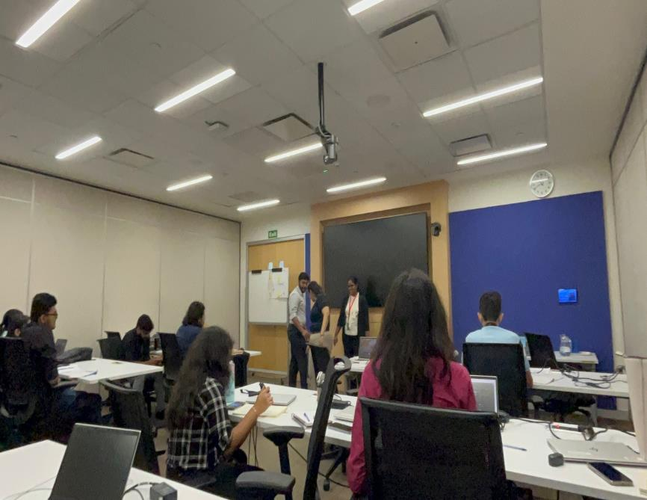
Learning is also Fun!
Please share how ”Your” learning was fun this week
Puzzle 1: Identify the correct Azure service for hosting a web application.
Puzzle 2: Configure an Azure Virtual Machine with specific requirements.
Puzzle 3: Set up an Azure SQL Database and retrieve data using SQL queries.

Slide 19

Summary
Connectivity of topics from current week
Continuous integration, delivery and deployment.
Azure Automation: Automates repetitive tasks and workflows for cloud management.
Azure DevOps: Manages CI/CD workflows for continuous integration and delivery.
Azure Logic Apps: Automates workflows by integrating apps, data, services, and systems.

Slide 20
Thank You

